Slide 1


Sprocket Central Pty Ltd
DATA ANALYTICS APPROACH
Shubha Hegde,
Data Analytics - KPMG

Slide 2

AGENDA
I. Introduction II. Exploration III. Interpretation

Slide 3
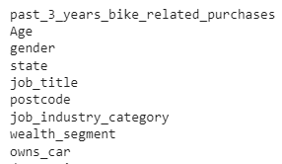
INTRODUCTION
The Dataset has been reduced to 9 important attributes and the Customer ID is the index. Customer Demographics and Address datasets have been merged.
Merging based on common Customer ID
provides insights on the various criteria
required to obtain high profits based on the
Age ( Engineered from DOB), Gender, State,
Job, Industry, Wealth, and explore previous
transactions for similar attributes provided by
the New Customer list.

Slide 4
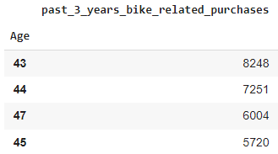
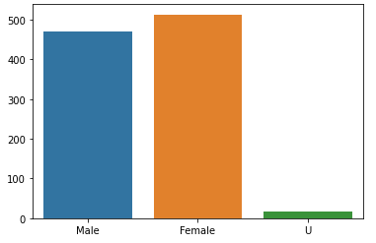
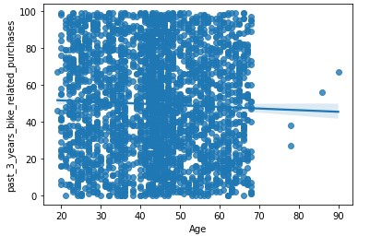
DATA EXPLORATION
AGE & GENDER
Age group 40-50 purchased the most related to bikes. The trend decreased with age linearly.
3.52% more females purchased from the client than males in previous transactions.
extra text here.

Slide 5
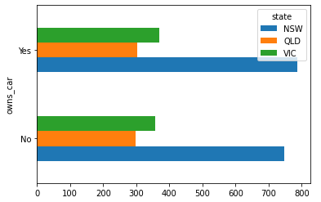
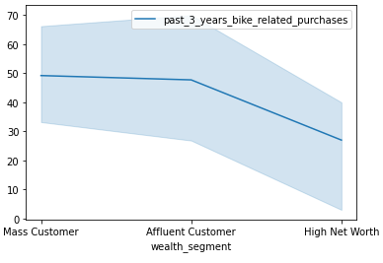
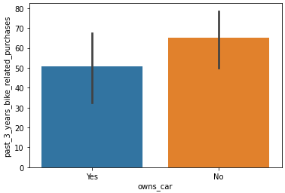
WEALTH SEGMENT & REGION
EXPLORATION
It is seen that Mass and Affluent Customers are more likely to purchase bikes whereas High Net Worth customers tend to utilize other modes. Bike related purchases were less for Customers owning cars, hence target customers should have no cars.
Victoria has been the one with most customers.
It is seen that Mass and Affluent Customers are more likely to purchase bikes whereas High Net Worth customers tend to utilize other modes. Bike related purchases were less for Customers owning cars, hence target customers should have no cars due to which they purchase bikes.
Victoria has been the one with most customers.
.
text here.

Slide 6
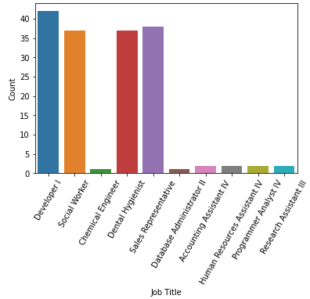
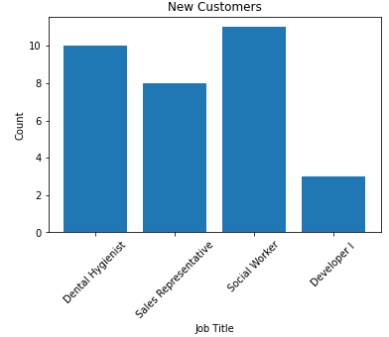
JOB TITLE AND JOB INDUSTRYDation
IInterpretatWEALTH SEGMENT & REGION
Exploring the data led us to the conclusion that the frequency of Developers and Sales Representatives purchases was high, whereas the frequency of Chemical Engineers and Database Administrator II was the least. Count of new customers of Job titles which can be highly profitable has been displayed below, with Social Workers having a high frequency, although Developer I has decreased significantly.

Slide 7
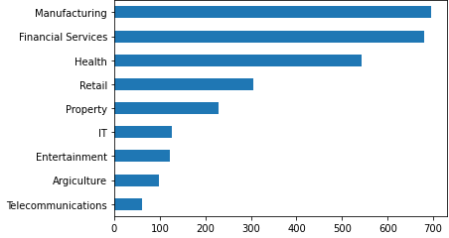
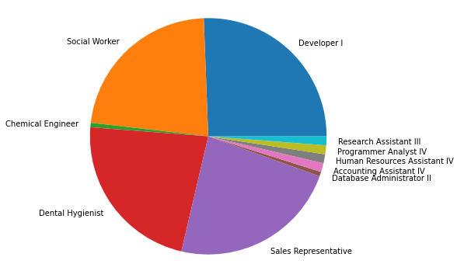
Below is a pie chart of the Job Titles for a better understanding of profitable clients.
We see that Customers in Industries like Manufacturing and Financial Services form a major chunk of the clients, which supports our previous claims that Developer, Sales Representative Job titles account for the most purchases. whereas Chemical Engineer, Database Administrator II, Programmer Analyst IV which compose IT sector, are the least profitable.
.

Slide 8
INTERPRETATION
The above Data Insights provide a good foundation for the type of Customers one should seek out to maximize the purchases, resulting in excess profit for the company along with good customer service to the client, based on features engineered from existing attributes like Age, along with taking into account the fact that Customers living in Regional areas determined by postcode and without cars are more likely to use bikes and purchase items from Sprocket, and Customers with specific jobs and net worth are more likely to use other modes of transport like cars or private jet resulting in low cash flow for the company.
We also uncovered that factors like gender don’t play a major deciding role.

